Slide 1
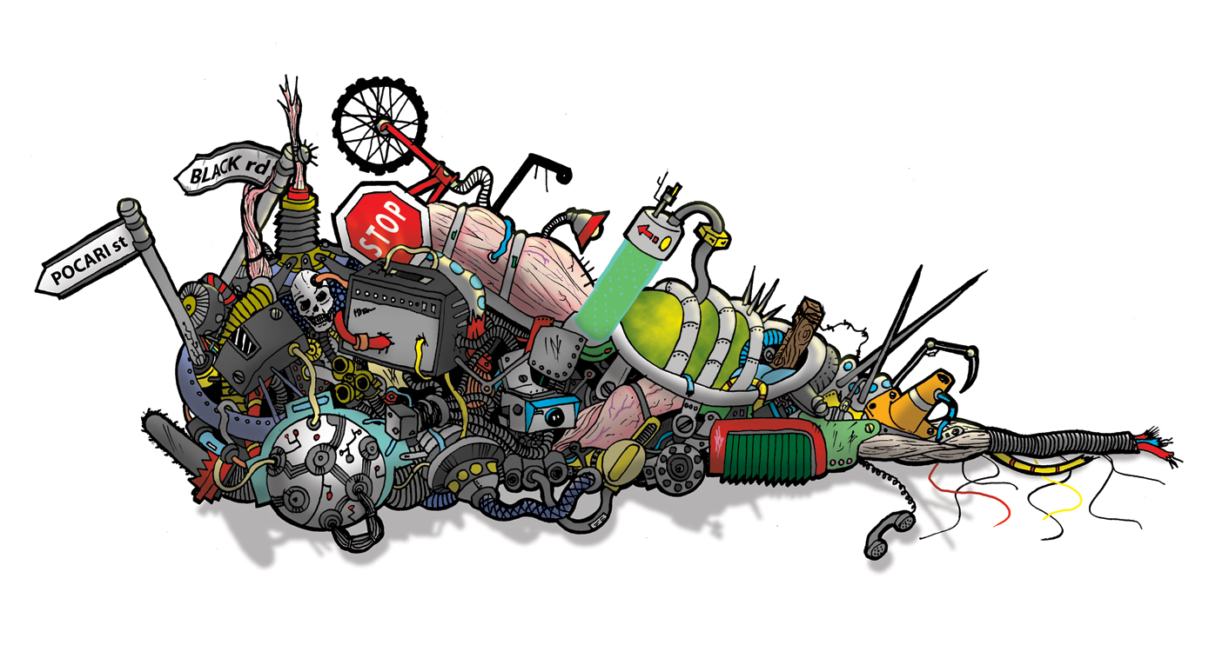

Garbage Monitoring Path System
21400772 최인회, 21100242 박경배, 20900527 이원희
Notes:
Currently, the world is facing many social, political and environmental issues. As a student living in Yangduk, we noticed an issue with garbage collecting system.

Slide 2
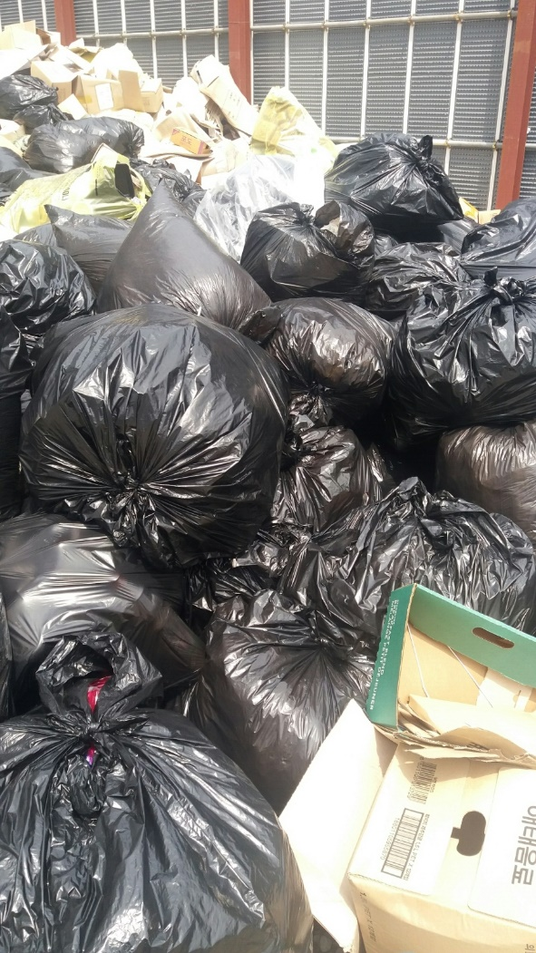
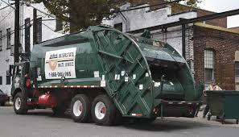
Notes:
On certain days of the week, there would be mountains of trash, however, on the other hand,

Slide 3

Notes:
, there were days with only a handful of plastic bags lying around. We saw an issue here. No matter how little trash was there, the garbage truck came every morning.

Slide 4
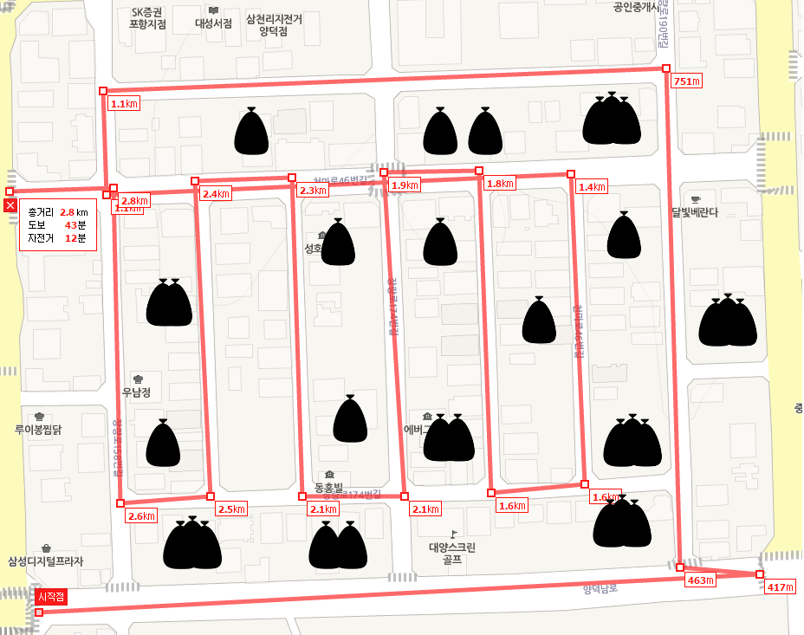
Day 1 + 2 Total km = 2.8 km *2 = 5.6 km Estimated clean time = 40*2 = 80 minutes Fuel cost = 4.35 lt *2 = 8.7 liters
Notes:
The truck would go through every corners, and streets, collecting garbage, no matter how much there is

Slide 5
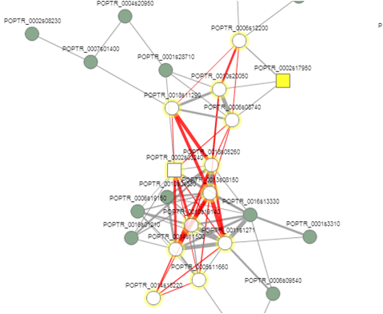
Proposed plan
Use efficiency to reduce…
Energy
Time
Effort
Create a path for the garbage trucks
Efficient pathway
Notes:
SO, we would like to propose a system, where it uses efficiency, to reduce energy used, time and effort.

Slide 6
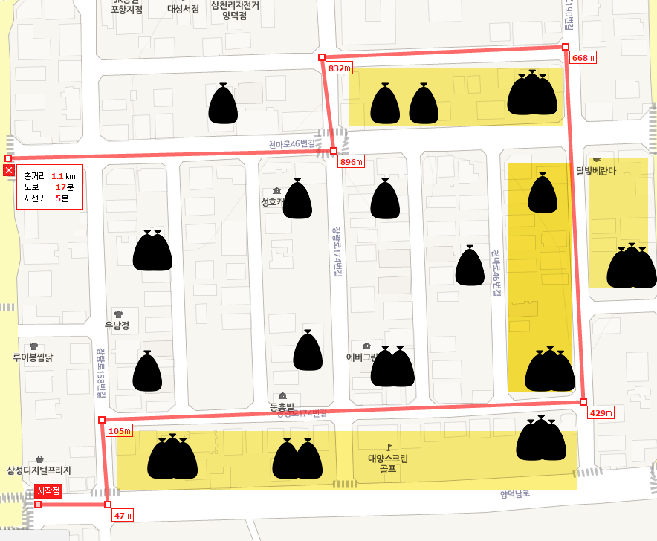
Day 1 Total km = 1.1 km Estimated clean time = 15 minutes Fuel cost = 1.28 lt
Notes:
If we were to create a path for the garbage truck, according to how much garbage was put out, we could use this to create efficient path, ignoring areas where the accumulated amount of garbage is not up to a standard.

Slide 7
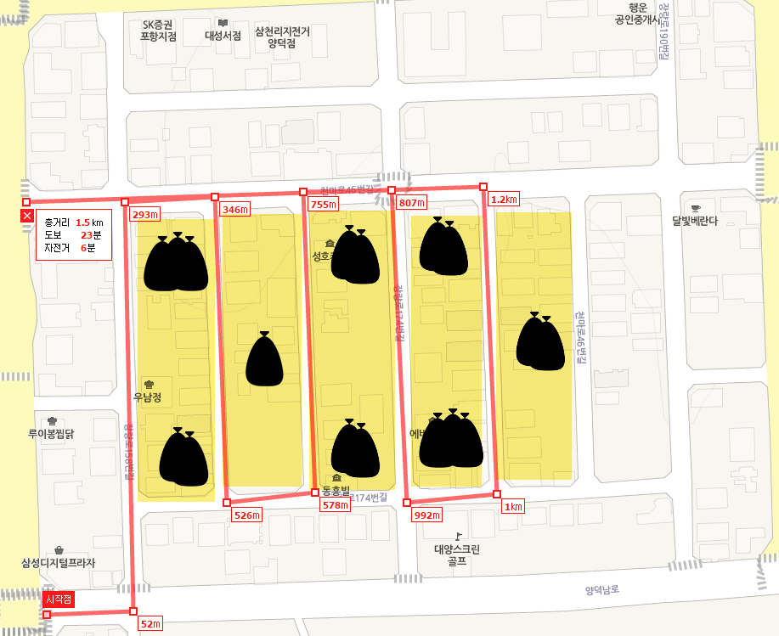
Day 2 Total km = 1.5 km Estimated clean time = 20 minutes Fuel cost = 1.74 lt
Notes:
Areas with little garbage would be skipped and monitored until it would have enough trash to be picked up.

Slide 8
53% reduction in km, 62.5% reduction in time, 65.3% reduction in fuel.
Notes:
As you can see, from the result, this can greatly reduce, energy, time and effort. So to introduce our app. Our app is separated in to two parts. One for the users, and one for the managerial team of the garbage collecting institution. Registered users will upload their garbage information in liters. These accumulated data will give a clear presentation of the amount for the managerial team to decide on their efficient pathway. We thought about persuading the institution to give incentives to the users with garbage bags according to how many times the user uploaded a data. This would create a win-win situation for both of the parties

Slide 9
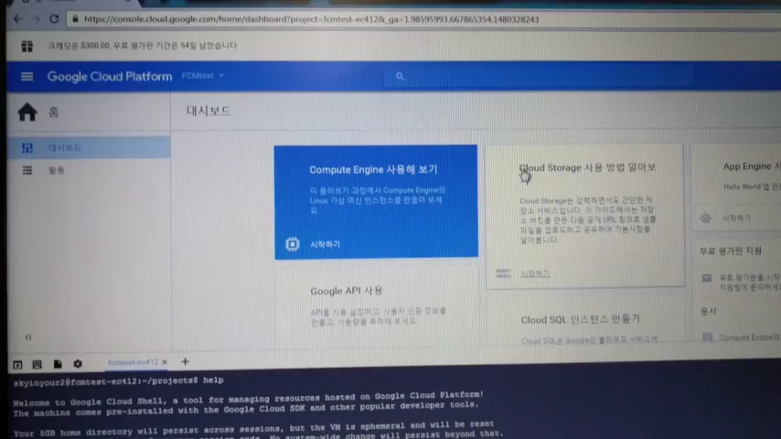
Simple Demo
Notes:
Before we show our demo, we would like to remind you that, Professor Kim has asked us to keep this project SIMPLE. We haven’t implemented everything we thought of, but if we did, this would be on par with a capstone project.

Slide 10
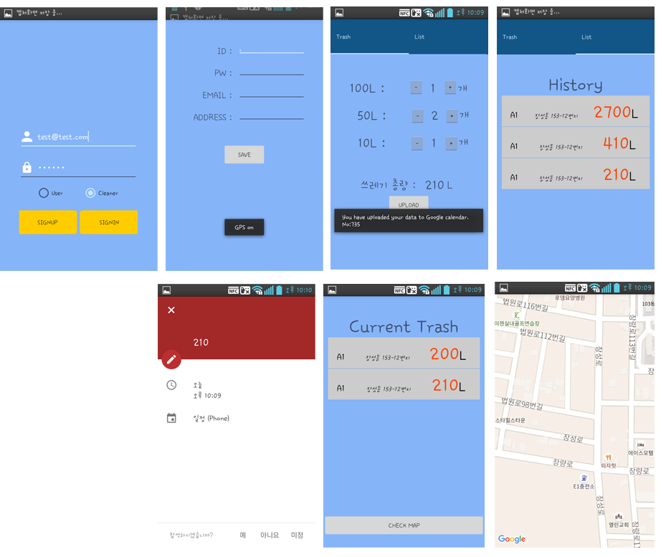
Notes:
So, here we have a login page, separated in to the two groups. New users can sign up through this button.
This is the sign up activity, where it is ready for server auto addressing implementation.
If you sign in as a user, you can set the amount of trash by 100, 50, 10 and upload it. On the right fragment, history can be implemented using list view or calendar view. If you sign in as a cleaner, you would receive the accumulated data and amount of trash thrown away, we can further develop the map part to receive the data and plot points on the map so that they can have a clear view of the route.

Slide 11
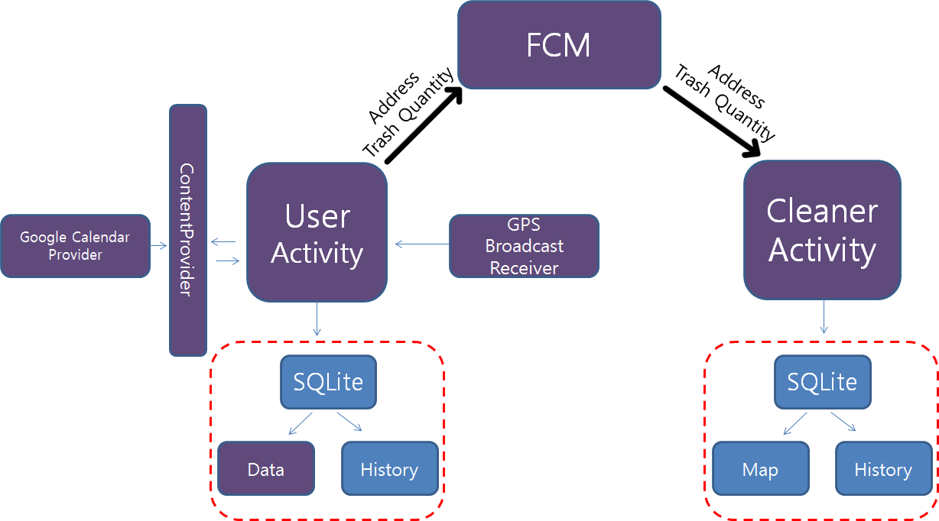
Implementation
MainActivity :
log-in function.
UserActivity :
sending message to Firebase Cloud server to notify cleaner-mode users.
contents of a message will be saved in SQLite Database and Google Calendar.
CleanerAcitivity :
Receiving message from Firebase Cloud server.
FCM : FCM(FirebaseCloudMessaging) is a connector between User and Cleaner.
GPS BroadCastReiver :
GPS will be needed. If user didn’t turn on GPS, It would alarmed users to turn on GPS through Toast message.
Notes:
So this is our Block Diagram.
The main activity has a log-in function.
The major purpose of useractivity is sending message to Firebase Cloud server to notify cleaner-mode users. Also it uses content provider to read and add data into Google calendar.
The major purpose of this cleaneractivity is receiving message from Firebase Cloud server. When it receives message, message will be saved into SQLite Database and showed up through list-view.

Slide 12
Small explanations…
Notes:
FCM(FirebaseCloudMessaging) is a connector between User and Cleaner.
GPS BroadCastReiver is When users join our system, they have to write their address. So, GPS will be needed. The Advanced features we used were the Google map and FCM system.

Slide 13
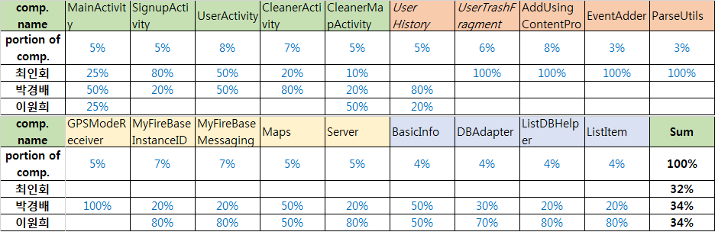
Contributions
Notes:
As you can see we have evenly distributed our work well.
By the end of the project we were overwhelmed but the fact that we finished gave me more motivation to work harder. After finished our project, I felt that building a large application is very hard. There were a lot of exceptions or errors. In design and implementation process, I learned that my plan was not perfectly achieved and 'good output' comes from 'good design'. With good team work and role allocation, we have achieved what once we thought was impossible.

